Slide 1
Osher Lifelong Learning Institute, Spring/Summer 2024
Contemporary Economic Policy
University of Kentucky
Geoffrey Woglom, Ph.D. (grwoglom@gmail.com)
National Economic Education Delegation

Slide 2
National Economic Education Delegation
Vision
  One day, the public discussion of policy issues will be grounded in an accurate perception of the underlying economic principles and data.
Mission
  NEED unites the skills and knowledge of a vast network of professional economists to promote understanding of the economics of policy issues in the United States.
NEED Presentations
  Are nonpartisan and intended to reflect the consensus of the economics profession.

Slide 3
Who Are We?
Honorary Board: 54 members
  2 Fed Chairs: Janet Yellen, Ben Bernanke
  6 Chairs Council of Economic Advisers
    Furman (D), Rosen (R), Bernanke (R), Yellen (D), Tyson (D), Goolsbee (D)
  3 Nobel Prize Winners
    Akerlof, Smith, Maskin
Delegates: 652+ members
  At all levels of academia and some in government service
  All have a Ph.D. in economics
  Crowdsource slide decks
  Give presentations
Global Partners: 48 Ph.D. Economists
  Aid in slide deck development

Slide 4


Where Are We?

Slide 5
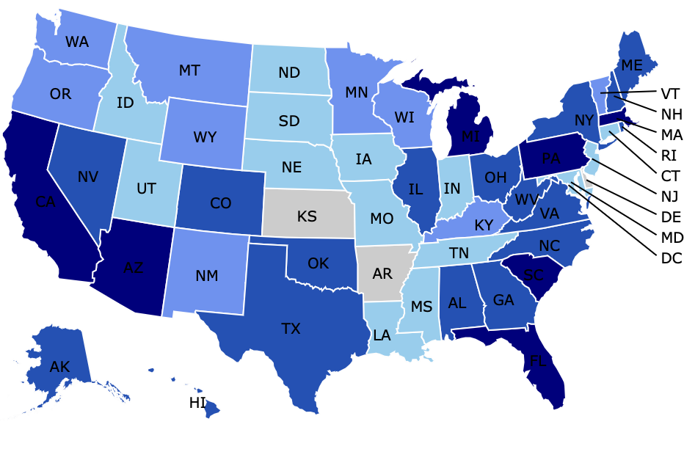
Where Have we Given Talks?

Slide 6
Available NEED Topics Include:
US Economy
Healthcare Economics
Climate Change
Economic Inequality
Economic Mobility
Trade and Globalization
Minimum Wages
Immigration Economics
Housing Policy
Federal Budgets
Federal Debt
Black-White Wealth Gap
Autonomous Vehicles
US Social Policy

Slide 7
Course Outline
Contemporary Economic Policy
  Week 1 (6/03): Economic Update (Geoffrey Woglom, Amherst College)
  Week 2 (6/10): Federal Debt and Deficits (Brian Peterson, Lagrange College)
  Week 3 (6/17): Trade and Globalization (Avik Chakrabarti, Univ. Wisconsin- Milwaukee)
  Week 4 (6/24): International Institutions (Alan Deardorff, University of Michigan)
  Week 5 (7/1): Climate Change Economics (Sarah Jacobson, Williams College)
  Week 6 (7/8 ): Is College Worth It (Geoffrey Woglom, Amherst College)

Slide 8
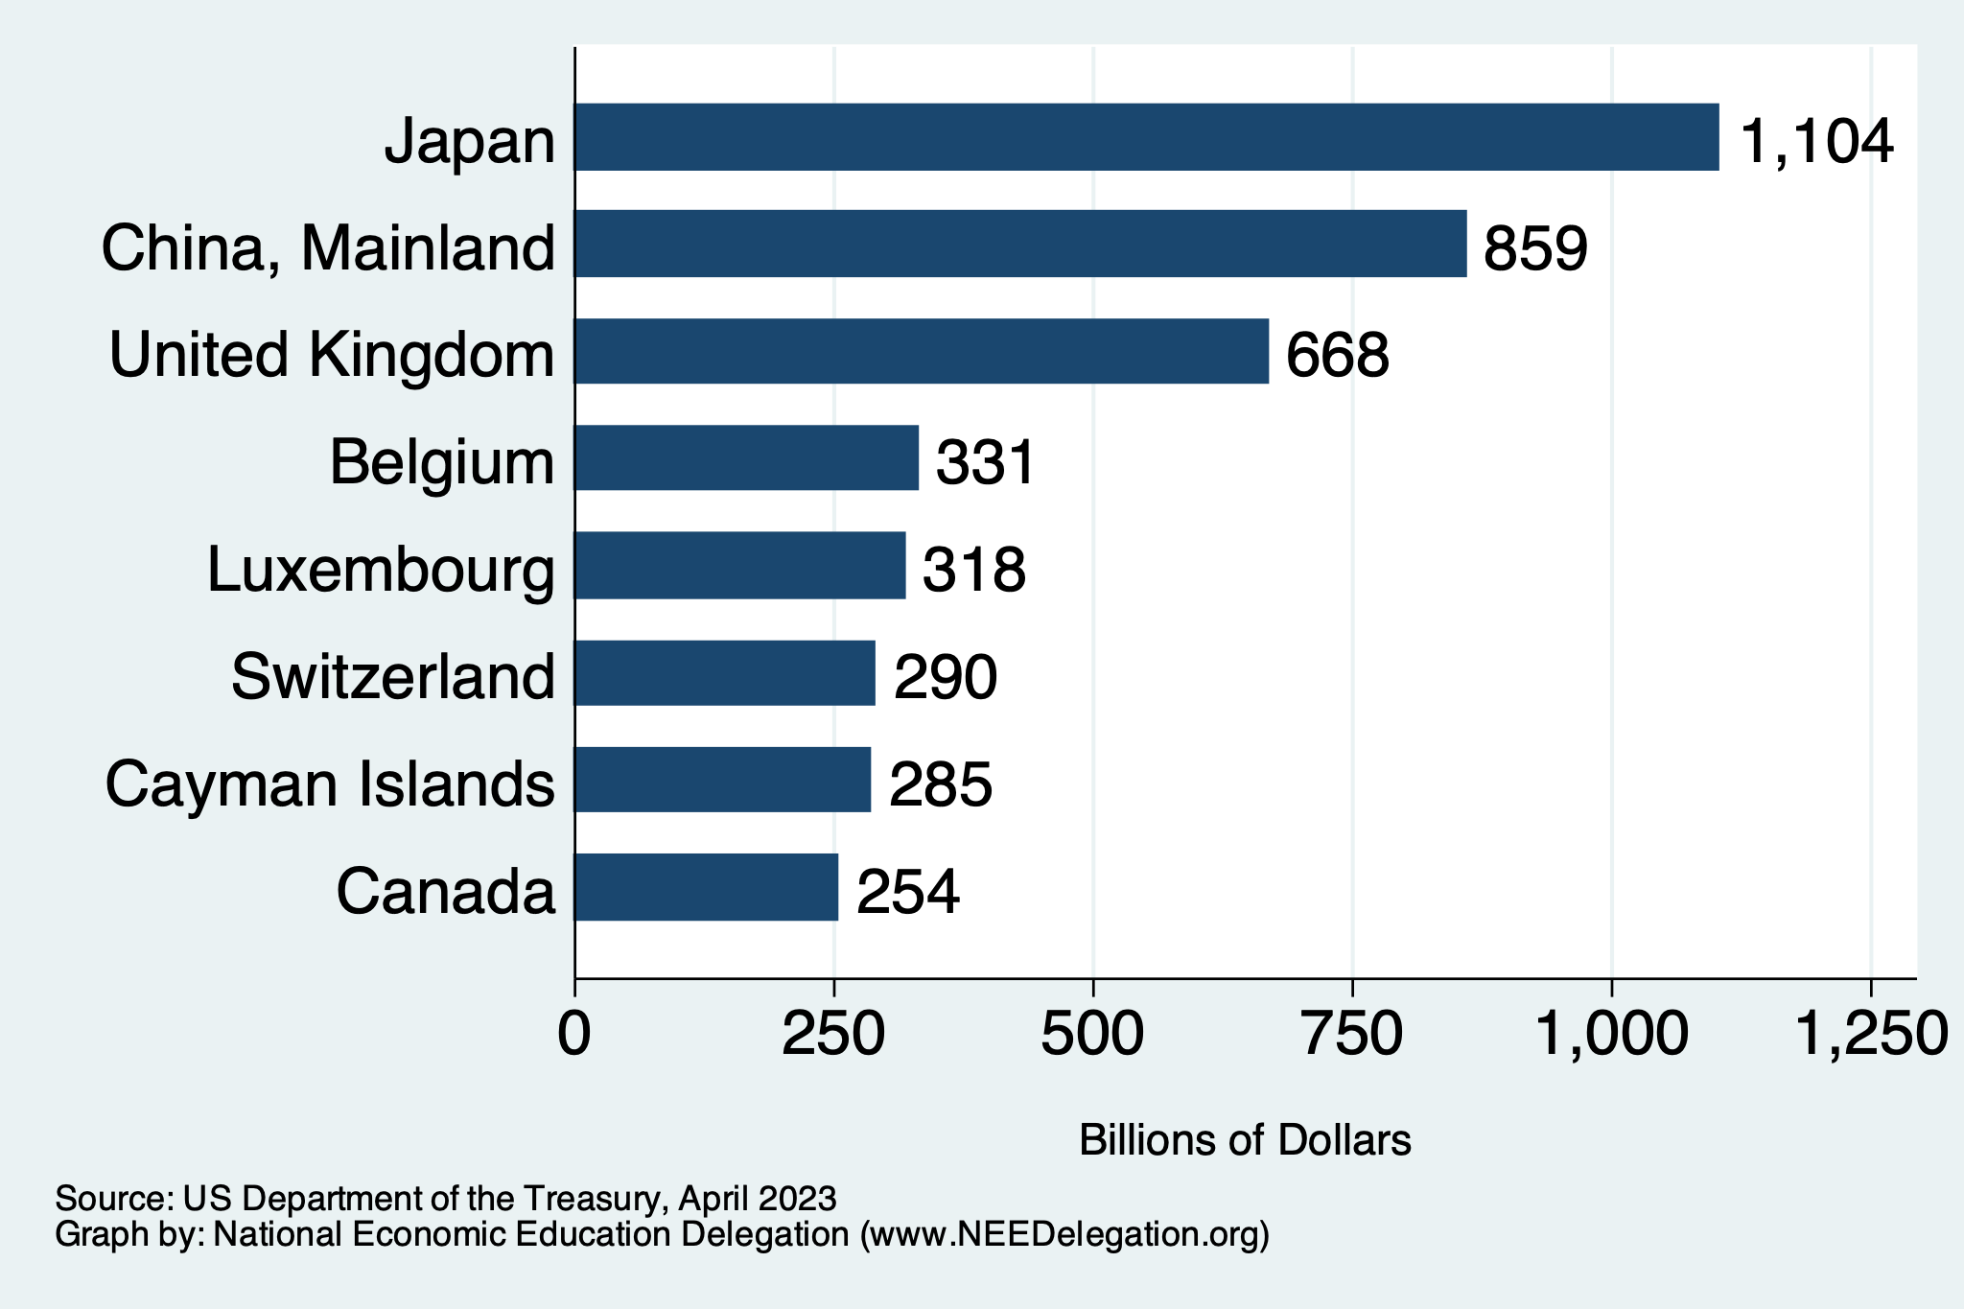
Who Holds US Debt?
https://ticdata.treasury.gov/Publish/mfh.txt

Slide 9
What is Globalization
  Global Value Chains
TRADE
  Foreign Direct Investment
  Financial Flows
  Migration
  International Travel

Slide 10

Main Economic Institutions
Notes:
https://sbhshgovapmacro.wordpress.com/2011/06/02/international-institutions/

Slide 11
How Economists Decide How Much to Fight
Climate Change: Cost Benefit Analysis
Abating greenhouse gas emissions is costly…
… but without action, climate change damages are even more costly.
Goal is not zero emissions, but efficient level that achieves a balance.
Expected costs of reducing emissions
Expected damages from allowing climate change

Slide 12
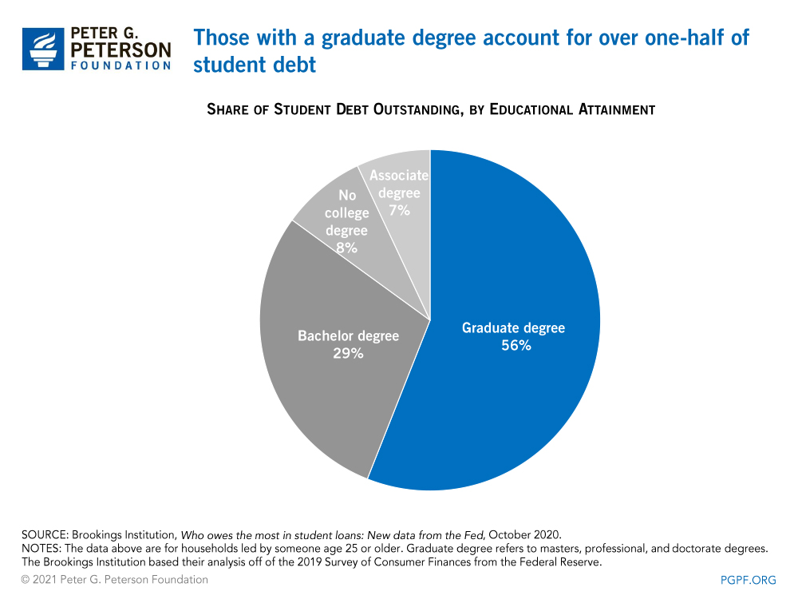
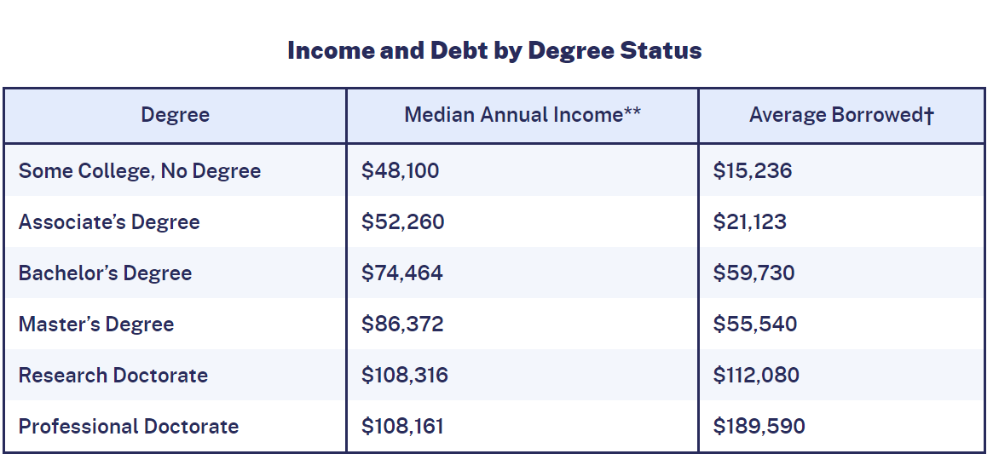
3. Student Debt Facts (Cont.)
https://educationdata.org/student-loan-debt-statistics

Slide 13
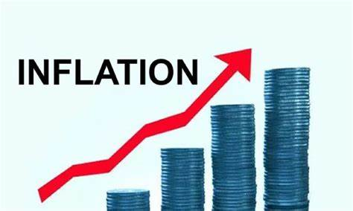
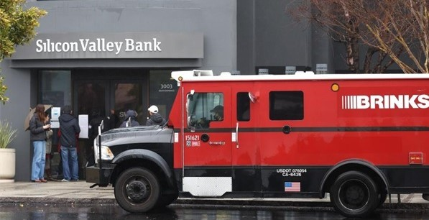
US Economy: Update
Geoffrey Woglom,
Professor of Economics
Amherst College, emeritus
June 3, 2024

Slide 14
Credits and Disclaimer
This slide deck was authored by:
  Jon D. Haveman, NEED
  Scott Baier, Clemson University
  Geoffrey Woglom, Amherst College (Emeritus)
  Brian Dombeck, Lewis & Clark College
  Doris Geide-Stevenson, Weber State
Disclaimer
  NEED presentations are designed to be nonpartisan.
  It is, however, inevitable that the presenter will be asked for and will provide their own views.
  Such views are those of the presenter and not necessarily those of the National Economic Education Delegation (NEED).

Slide 15
Submitting Questions
Submit questions in the chat or by raising your digital hand.
  I will try to handle them as they come up.
We will do a verbal Q&A once the material has been presented.
Slides will be available from the NEED website tonight (https://needelegation.org/delivered_presentations.php).
My macro site: https://sites.google.com/view/macro-current-issues/home

Slide 16
Outline for the Talk
Summary of the state of the macroeconomy.
The Effect of M&F policies on the recovery.
Describe an unprecedented monetary policy achievement that may be unfolding.
Major challenges and uncertainties going forward

Slide 17
Gross Domestic Product: 2023Q4 = $28.3 tr
$29.1
Less Imports
-$3.9
Plus Exports
+$3.1
Equals GDP
$28.3

Slide 18
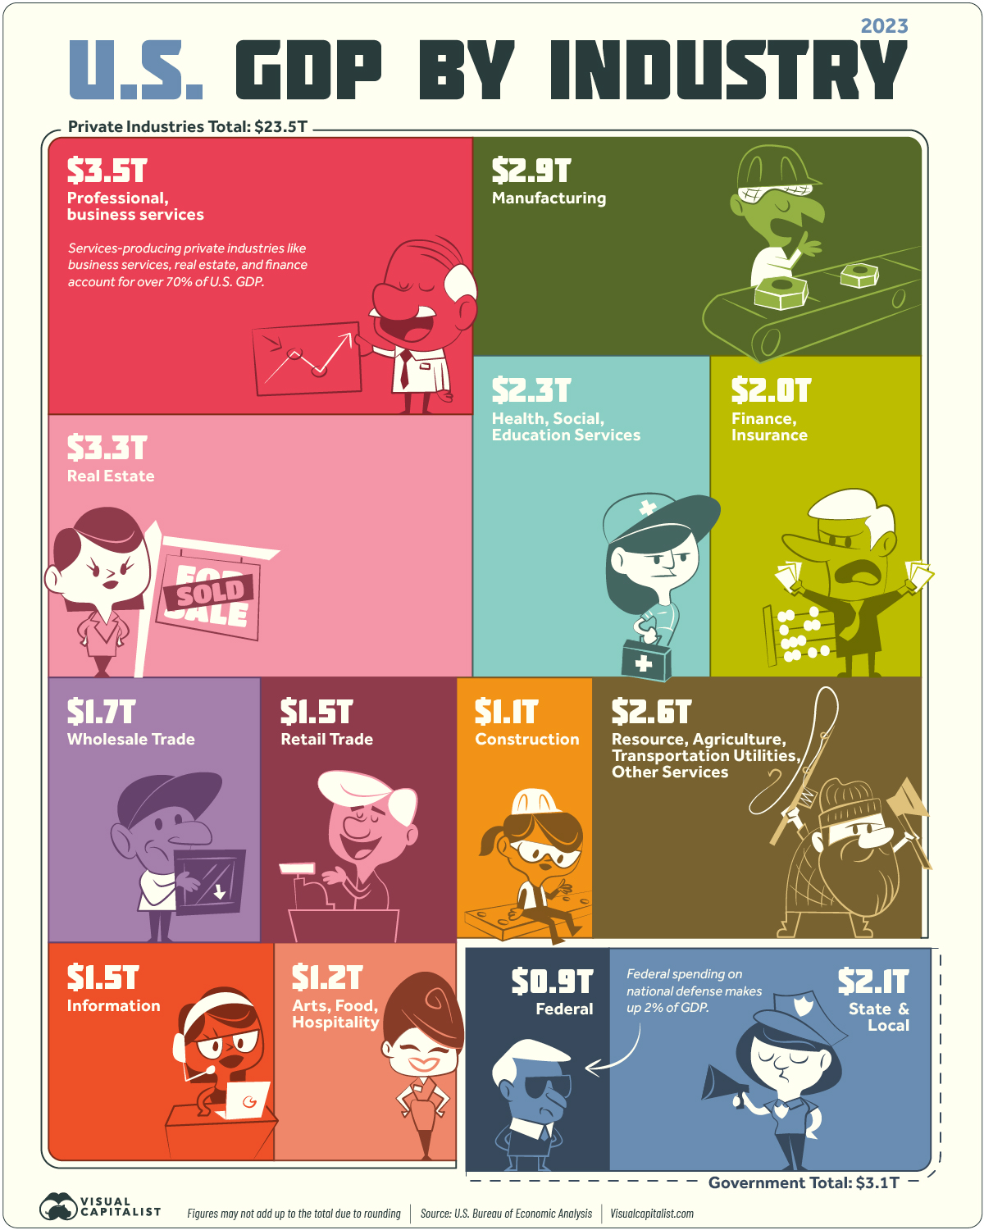
Different Breakdown
Note: State and Local Government comprises 10% of GDP!

Slide 19
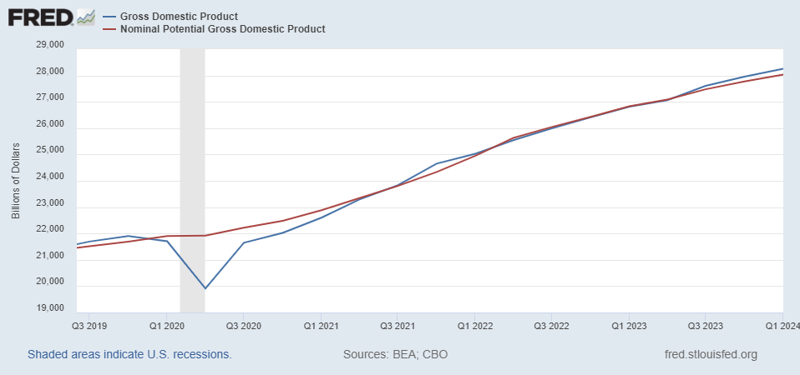
GDP and ‘Potential’ during the Recovery
Grey bar indicates recessions
Source: Fred, St Louis Fed

Slide 20
What is a Recession?
Defined by the National Bureau of Economic Research (NBER)
“The NBER's definition emphasizes that a recession involves a significant decline in economic activity that is spread across the economy and lasts more than a few months.”
Popular Rule of Thumb: Two or more, consecutive quarters where Real GDP falls. (Doesn’t always work!)
Recessions are caused by a drop in total spending.

Slide 21
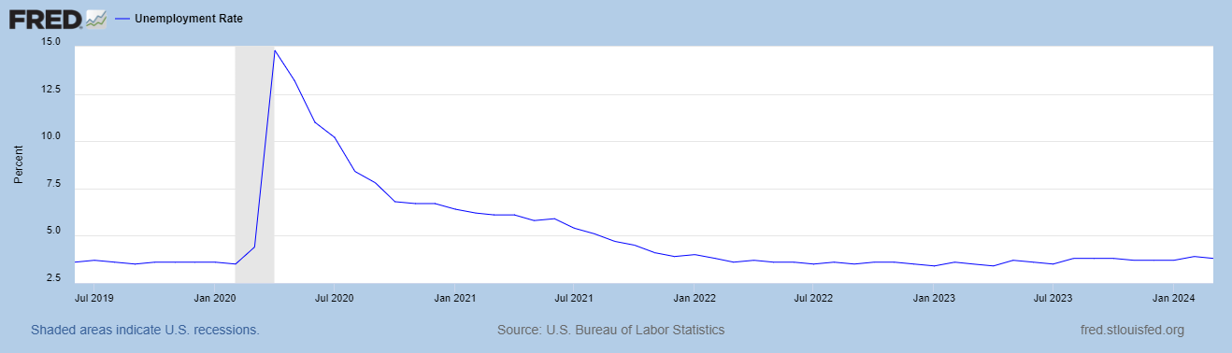
Unemployment is Near Record Lows

Slide 22
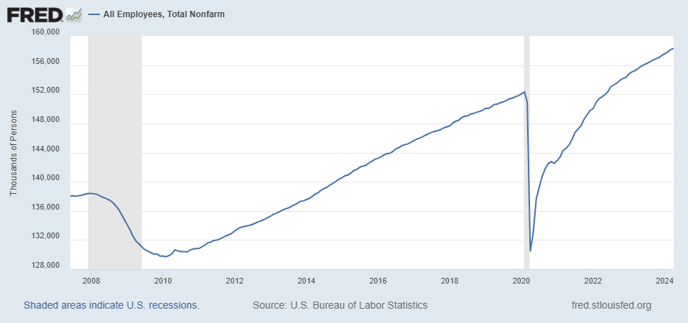
Where Have All the Workers Gone?
Notes:
Largely explained by baby boomer retirements and a little excess retirements due to COVID

Slide 23
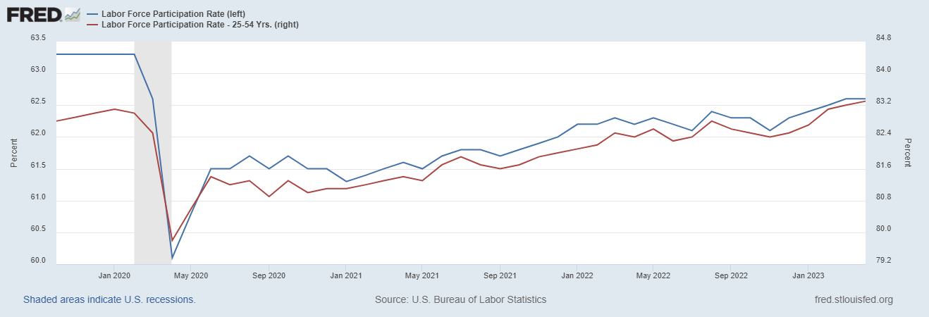
The Aging of the Labor Force

Slide 24
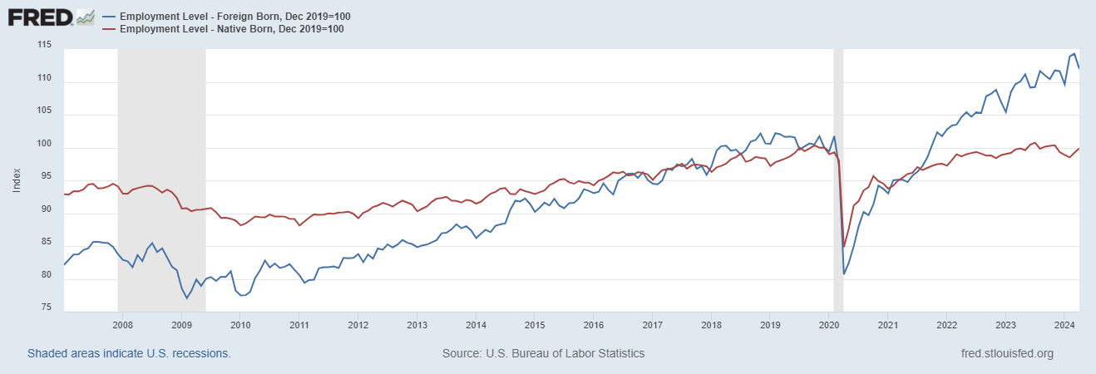
Supplemented by Foreign Workers

Slide 25
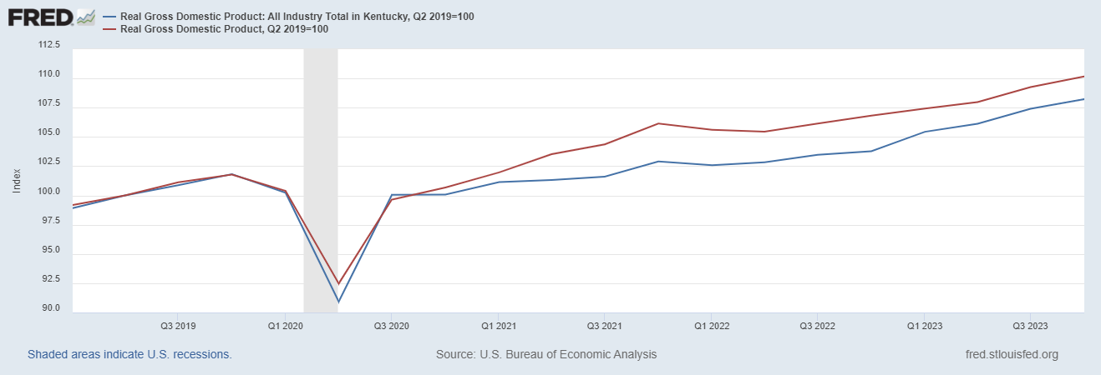
How is Kentucky Doing?

Slide 26
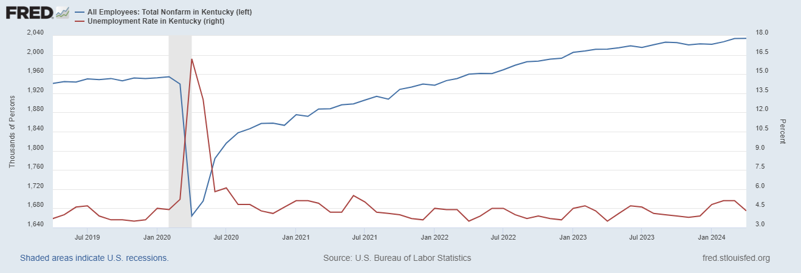
Labor Market in Kentucky
Notes:
REI < 1% increase in employment vs. 3.6% nationally

Slide 27
Overall Good News on the Real Side
GDP is very close to its potential.
The labor market as measured by the unemployment rate is fully recovered.
There was no apparent Great Resignation
But there is also a nominal side: interest rates, asset prices, inflation and wages.
News isn’t so good, but is getting better.

Slide 28
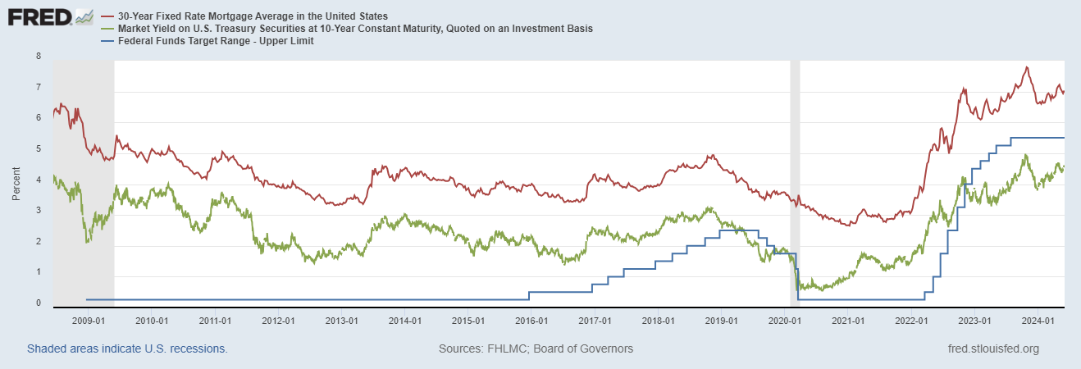
Interest Rates: Era of Falling Rates Over?
Notes:
Fed policy rate 4.5 to 4.25. Concerns with inflation

Slide 29
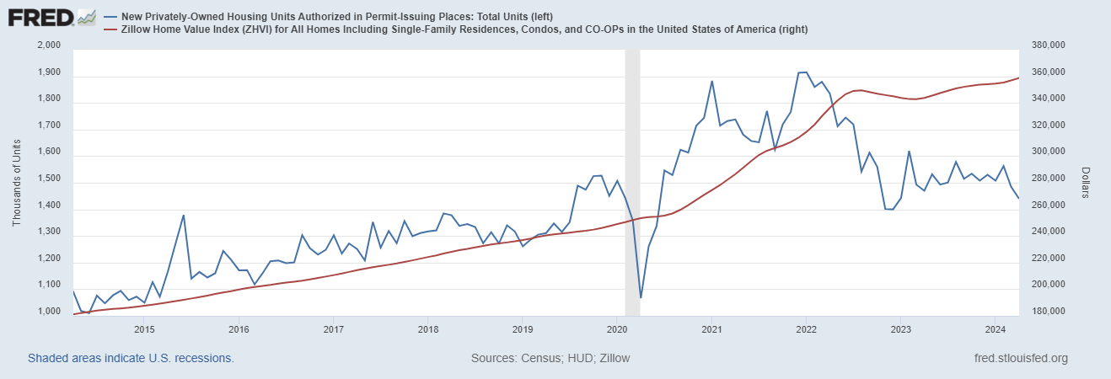
Mortgage Rates are Having an Effect ?

Slide 30
National Housing Market and Closer to Home
https://www.zillow.com/research/data/

Slide 31
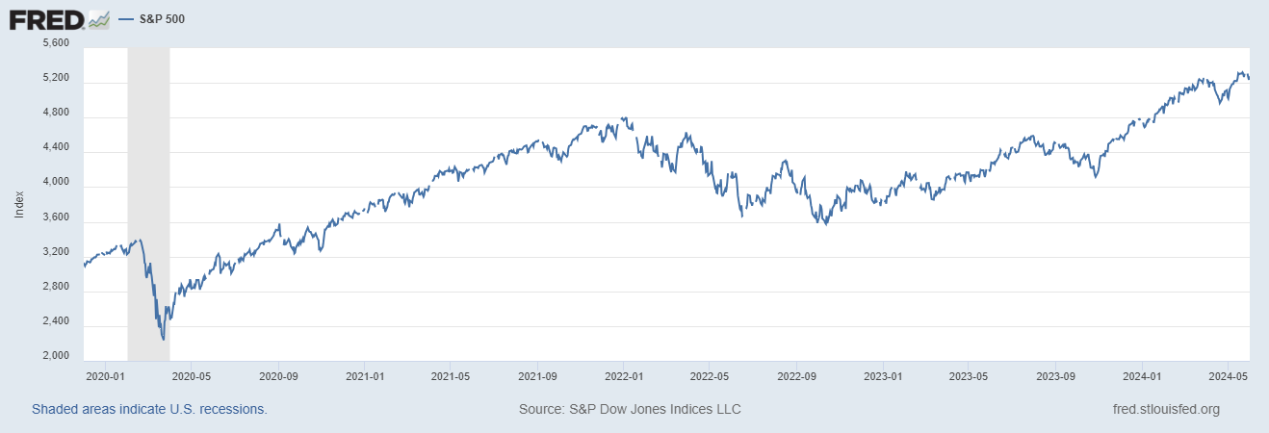
Stock Prices: Fear Giving Way to Greed?
Notes:
Since the end of 2021, lost almost 15%

Slide 32
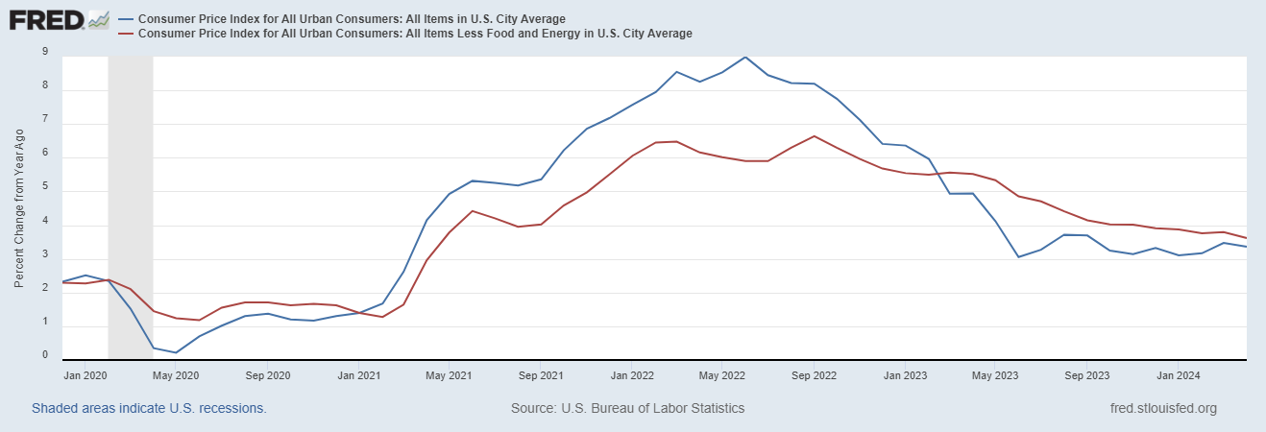
Inflation during the Recovery (CPI)
Notes:
August CPI yoy 8.3% down from 8.5 and Core 6.3 up from 6.3 in JUly

Slide 33
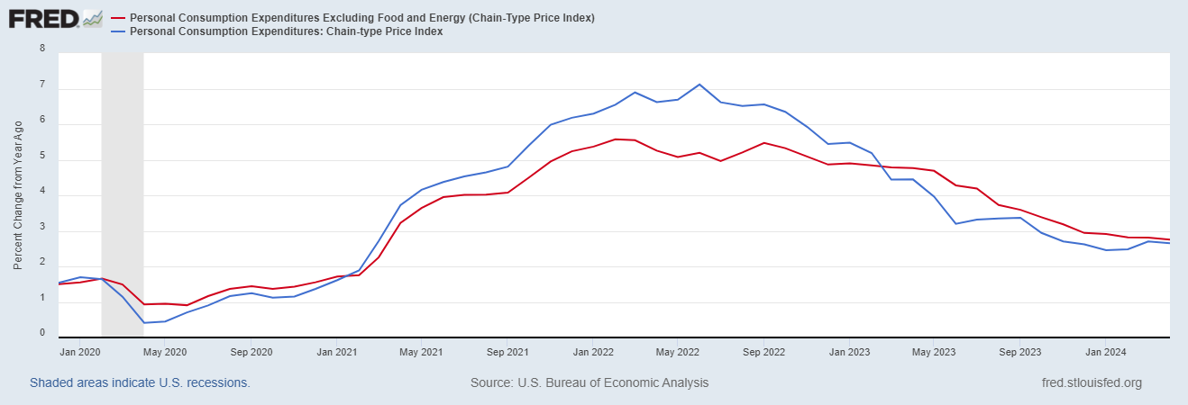
Fed’s Measure (PCE)
Inflation Accelerates 3/2021
Fed Doesn’t React until 3/2022
Looks Worrying?

Slide 34
CPI vs. PCE: Differences
CPI tends typically to be 0.3 pct point higher
April:
CPI, 3.4% PCE, 2.7%
Core CPI, 3.6% Core PCE, 2.8%.
https://www.businessinsider.com/pce-vs-cpi-weight-comparisons-2014-6

Slide 35
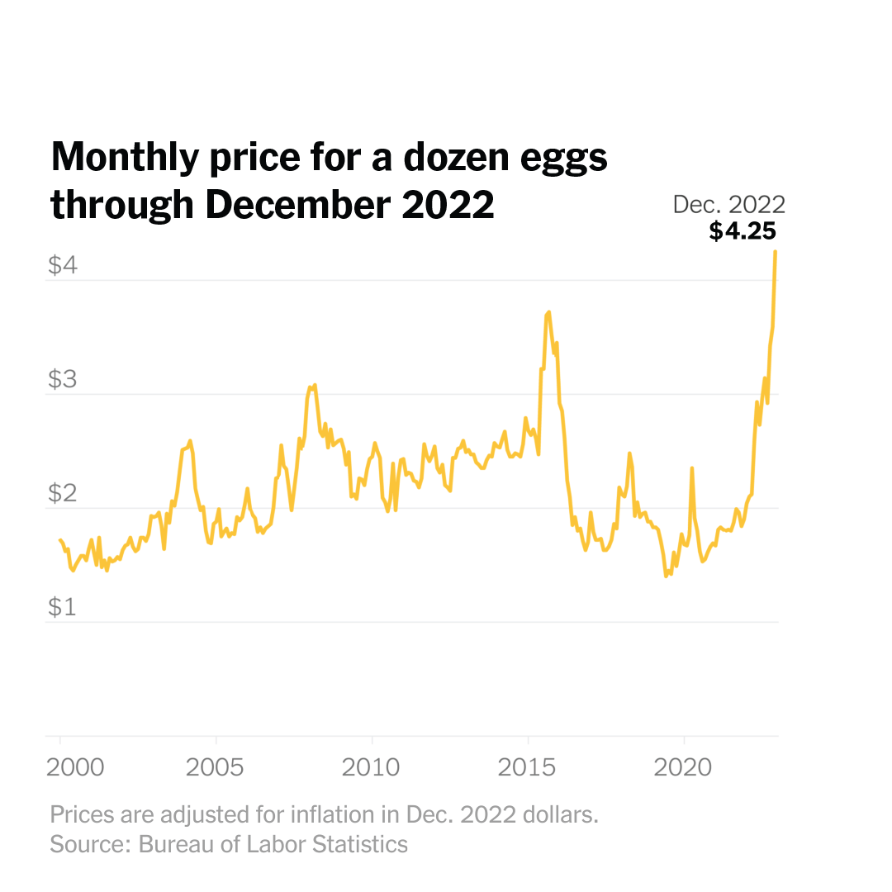
Uses of Inflation Measures
Two Reasons for Measuring Recent Inflation:
What has happened to the Cost of Living?
What is likely to happen to inflation over the next 12-18 months?

Slide 36
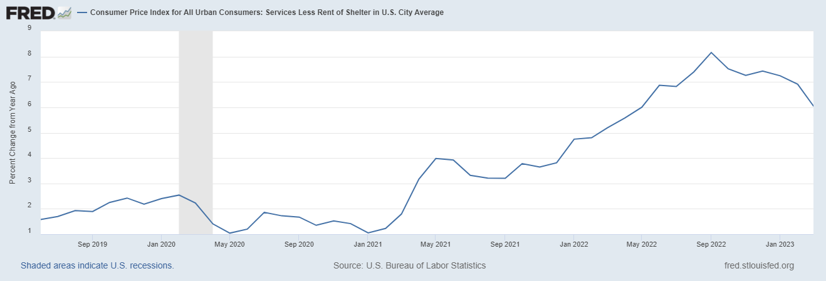
Measuring “Underlying” Inflation
Super Core!

Slide 37
The Importance & Problems with Rents
Notes:
Shelter is 36% of CPI and 45% of Core CPI. About half as much in PCE. CPI less shelter is 2.3% sine March of last year. Shelter is up 5.8%

Slide 38
Wages Haven’t Kept Pace with Inflation, Yet
Federal Reserve of Atlanta, “Wage Tracker” and BLS
Notes:
But, note that low wage workers are doing relatively the best

Slide 39
The “Nominal” Side
Inflation: A lot of progress on inflation, but the recent data are troubling.
But, this is not the popular view

Slide 40
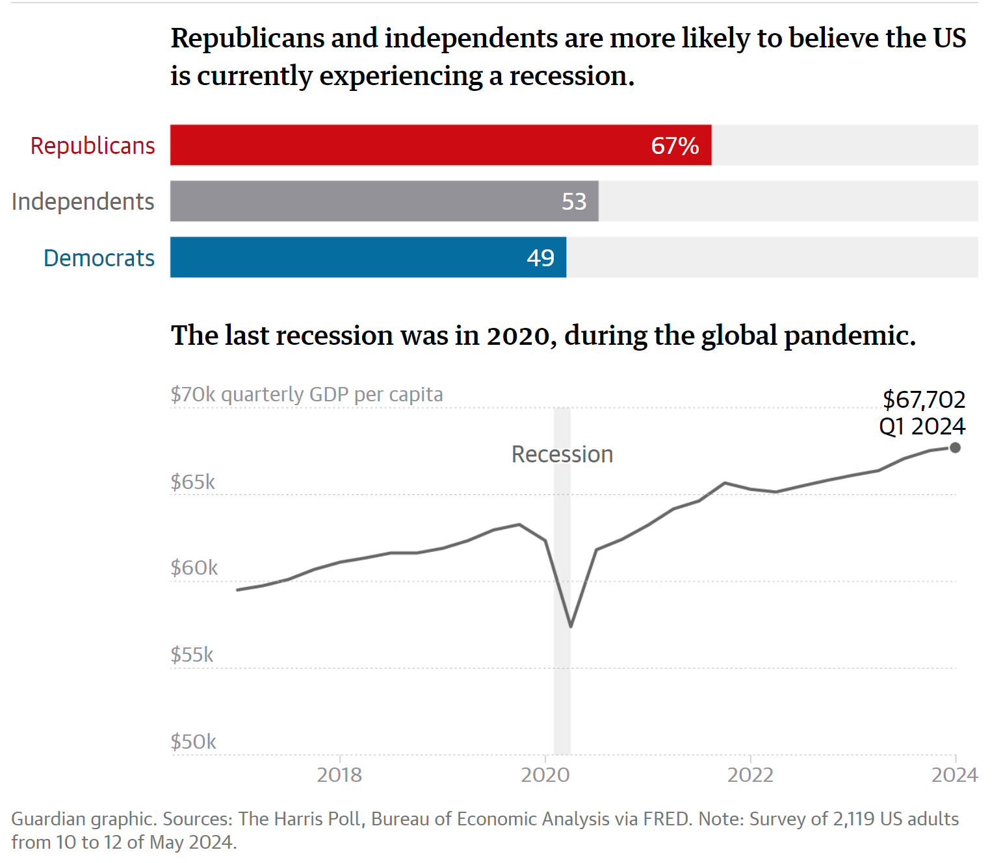
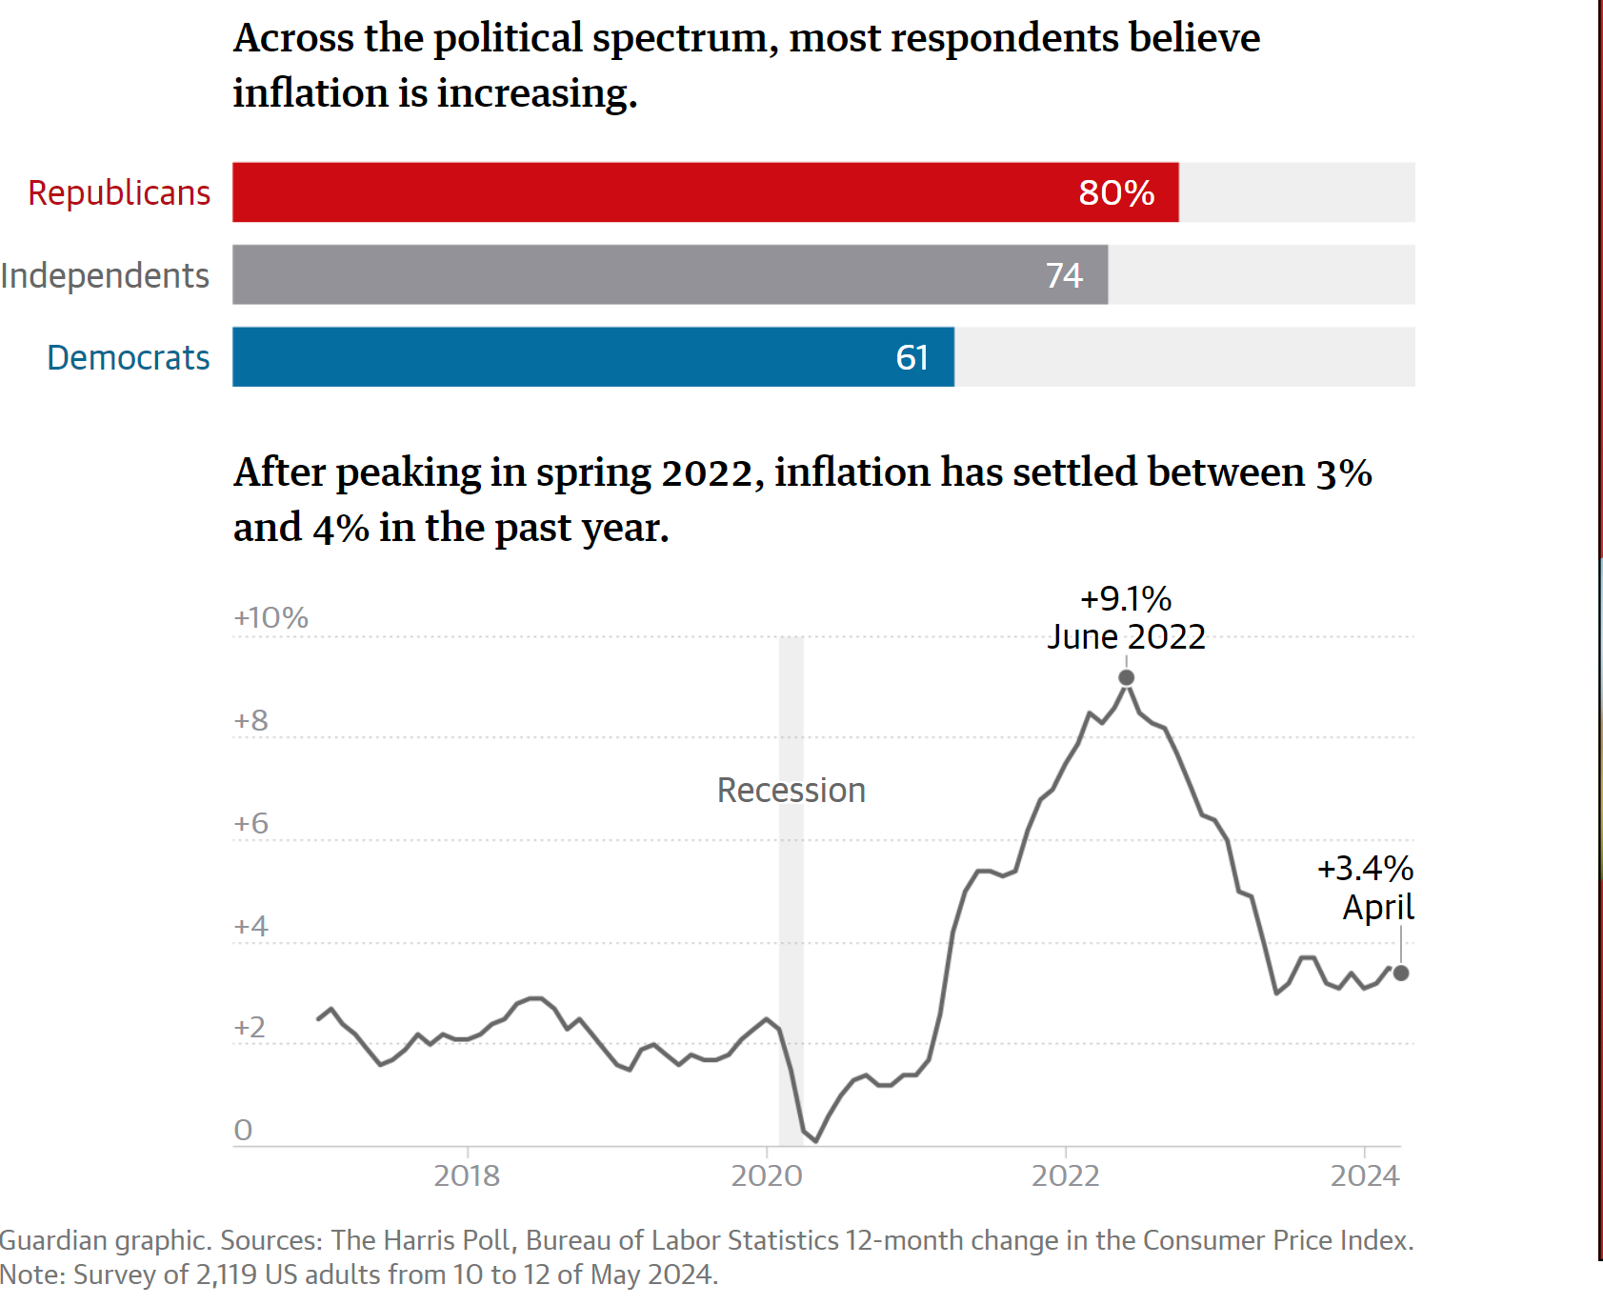
Why We Give These Lectures
https://www.theguardian.com/us-news/article/2024/may/22/poll-economy-recession-biden
Notes:
49% believe Stock Market is down, and unemployment is at a 50 year high

Slide 41
High Prices versus Inflation

Slide 42
Housing Prices Vs Inflation

Slide 43
Wages vs Prices and Inflation

Slide 44
Policy Effects
Stabilization policies aim to affect the level of total spending or “aggregate demand.”
Fiscal Policies of increasing spending and/or cutting taxes can raise total spending. (Congress and the President)
Monetary Policy affects total spending via interest rates: lower interest rates leads to more spending (the Fed)
Except in deep recessions, the Fed has primary responsibility for stabilization policies.

Slide 45
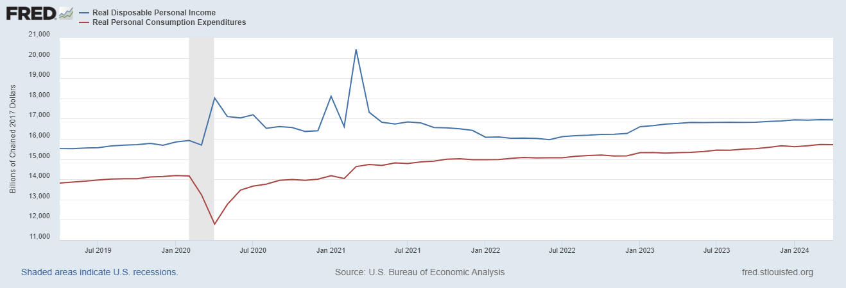
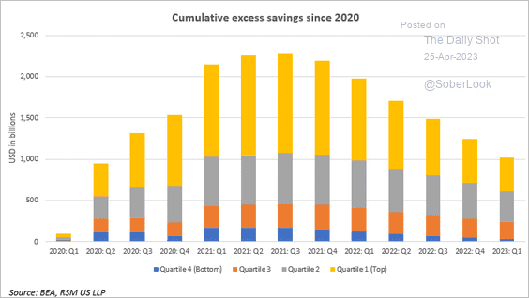
Policy Effects: Fiscal
2020-2021: massive stimulus, $4.6t: Cares Act, 3 rounds of stimulus checks, expanded unemployment benefits, Payroll Protection Loans.

Slide 46
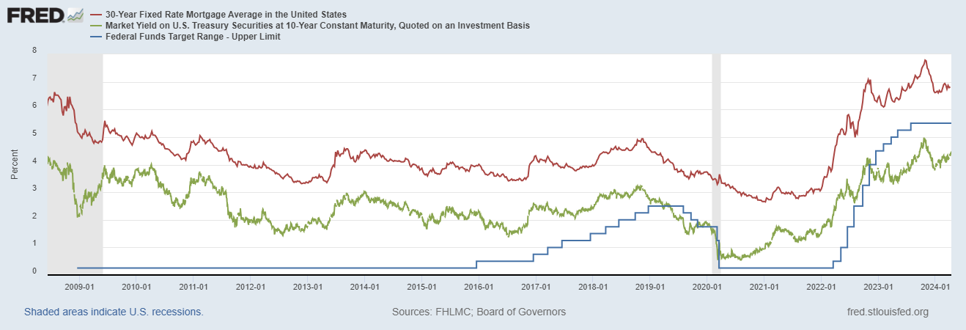
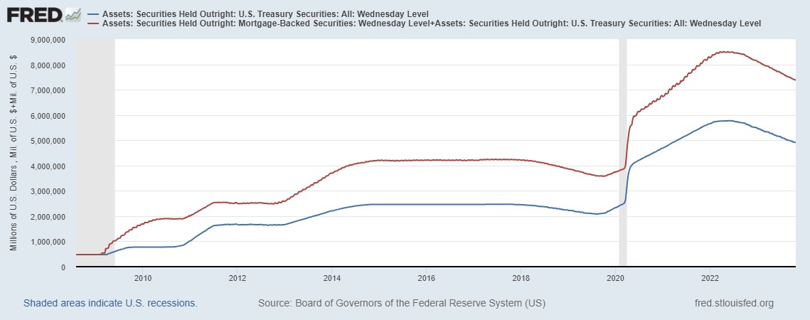
Policy Effects: Monetary
2020-2/2022: short term policy interest rate at zero, new round of quantitative easing.
3/2022-present: most rapid increase in interest rates since Paul Volcker

Slide 47
Fed’s Evolving Views on the Economy
March 2024
Austin Goolsbee, President of the Chicago Fed, The economy is on a “golden path” and will achieve the “mother of all soft landings.”
How did this happen?

Slide 48
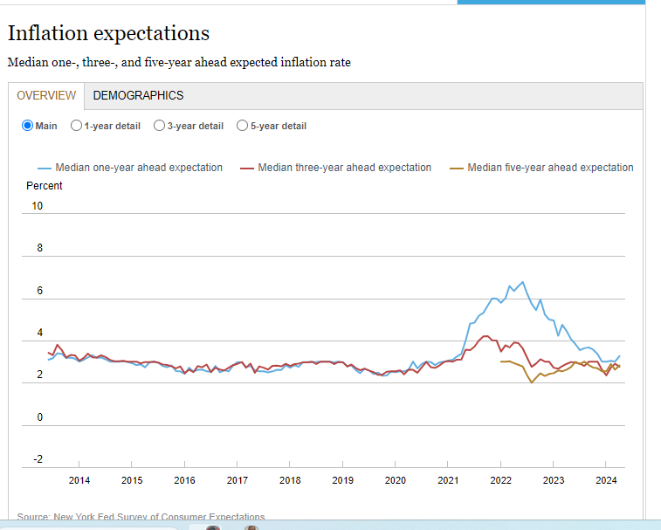
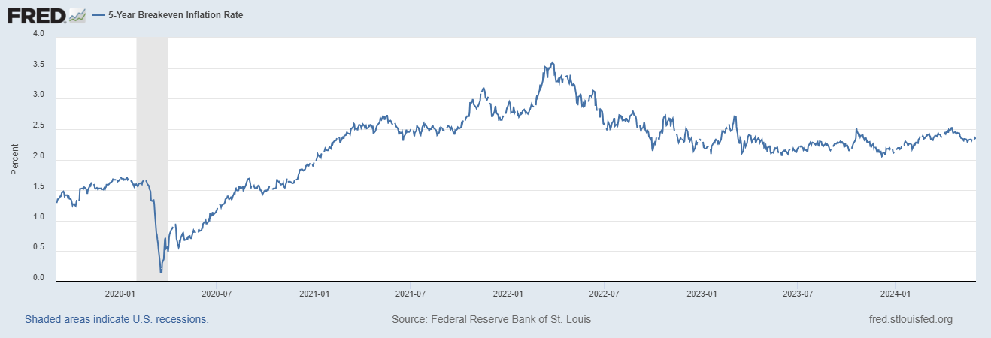
Long-Term Inflation Expectations Remained “Well Anchored”
Worrying?

Slide 49
Assessing Credit and Blame (my views)
Congress and the President: Fiscal Stimulus prevented deep world-wide recession. American Rescue Plan probably too big.
The Fed. Major blame for being late in reacting to increase in inflation. Since 3/22, so far so good. Verdict is out: good policy or good luck?

Slide 50
What will the Fed Do?
Pending Developments:
Consumption (2/3rds of GDP) appears to be slowing.
Progress on inflation in some doubt.
Wednesday, June 12 Fed policy meeting with new economic projections.
Politically Charged Environment!
Notes:
GDPNow 2.4%; blue chips consensus 1.5% implies 2.9%, or 2.7%

Slide 51
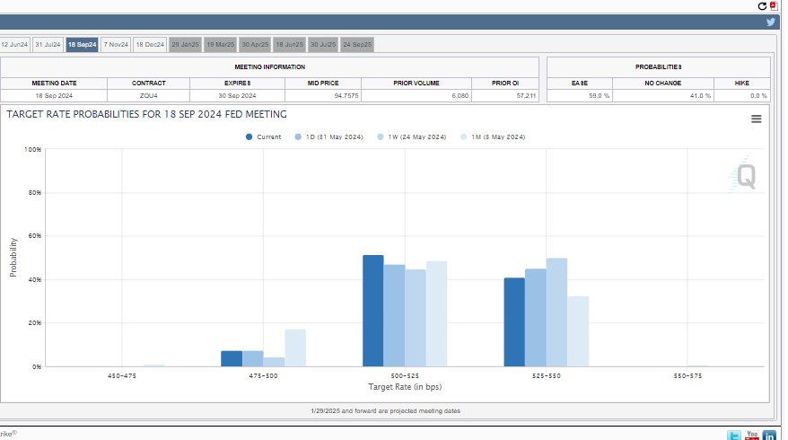
Interest Rate Cuts?

Slide 52
Let’s Hear from You!
Geoffrey Woglom grwoglom@amherst.edu
Contact NEED: Info@NEEDEcon.org
Support NEED: www.NEEDEcon.org/donate.php

